Slide 1


PANIMALAR ENGINEERING COLLEGE Department of Computer Science
third project review
DRUG DISCOVERY
Domain: Machine Learning
Team Members:
S. YATHIN (2017PECCS256)
K. SATHIYAN (2017PECCS262)
P. SANTHOSH (2017PECCS287)
Project Guide:
A. KARTHIKEYAN

Slide 2
ABSTRACT
At present, There are many diseases in the world for which the vaccine or the drug to cure those disease is not found and also for a new diseases which can come in future it takes Time and more Capital to find a cure for these diseases. The concept of DRUG DISCOVERY benefits the society, particularly the aging society in a very significant manner. The general meaning of Drug Discovery is the process underpins the entire pharmaceutical industry, encompassing the early stages of research from target discovert and validation, right through to the identification of a drug candidate or lead compound.

Slide 3
TECHNOLOGY STACK
Machine learning (ML) is the study of computer algorithms that improve automatically through experience and by the use of data. It is seen as a part of artificial intelligence. Machine learning algorithms build a model based on sample data, known as "training data", in order to make predictions or decisions without being explicitly programmed to do so.
Machine learning algorithms are classified into four categories:
1. Supervised learning,
2. Un-supervised learning,
3. Semi-supervised learning,
4. Reinforcement learning.

Slide 4
MODULE DESCRIPTION
MODULE
Dataset
SMILES Representation of Molecules
Model

Slide 5
DATASET
A dataset containing drug molecules (encoded as SMILES) and their binding affinities. The task is to use this dataset to make a regression model for binding affinity prediction.
The protein functions can be stopped by introducing drug molecules that are capable of blocking the protein. In other words, preparation of a drug involves finding molecules that can effectively bind to the protein i.e have a high binding affinity.
The data has been generated using Protein-Ligand docking

Slide 6
SMILES Representation of Molecules
SMILES are character strings to represent drug molecules. For example, carbon atom can be represented as “C”, an oxygen atom can be represented as “O”, double bond by “=”. The molecule Carbon dioxide is represented as “C(=O)=O”.
SMILES | NAME
CC | ethane
O=C=O | Carbon dioxide
C#N | Hydrogen cyanide
CCN(CC)CC | Acetic acid
[OH3+] | Hydronium ion

Slide 7
Model
We load trained mol2vec which is trained on Morgan fingerprints with radius = 1 to yield 300 dimensional embeddings. Link to load trained mol2vec

Slide 8
ALGORITHM
We split the data into train and validate and analyze with various different regression algorithms like Ridge, svm, lasso, etc and also with their different parameters.

Slide 9
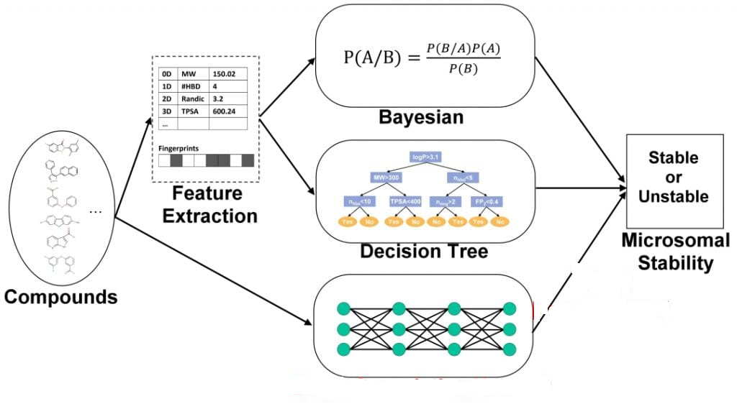
SYSTEM ARCHITECTURE

Slide 10
DEVELOPMENT ENVIRONMENT
HARWARE REQUIREMENTS
Processor : Intel Pentium Dual Core 2.00GHz
Hard disk : 500 GB
RAM : 8 GB (minimum)
SOFTWARE REQUIREMENTS
Python 3.6.4 Version
Anaconda

Slide 11
CONCLUSION
ML-based techniques seek to revitalize the development of drugs. These methods are based on separate applications in target discovery, lead compound discovery, synthesis, protein-ligand interactions, etc. ML applications are paving the way for algorithm-enhanced data query, analysis, and generation. One such example is ML incorporated into target discovery, based heavily on the refinement and search of existing omics and medical data. Owing to more precise algorithms, more powerful supercomputers, and substantial private and public investment into the field, these applications are becoming more intelligent, cost-effective, and time-efficient while boosting efficacy.

Slide 12
REFERENCE
1. Fayyad, J.; Jaradat, M.A.; Gruyer, D.; Najjaran, H. Deep Learning Sensor Fusion for Autonomous Vehicle Perception and Localization: A Review. Sensors 2020, 20, 4220. [CrossRef] [PubMed]
2. Deng, L.; Li, X. Machine Learning Paradigms for Speech Recognition: An Overview. IEEE Trans. Audio Speech Lang. Process. 2013, 21, 1060–1089. [CrossRef]
3. Afouras, T.; Chung, J.S.; Senior, A.; Vinyals, O.; Zisserman, A. Deep Audio-visual Speech Recognition. IEEE Trans. Pattern Anal. Mach. Intell. 2018, 1. [CrossRef] [PubMed]

Slide 13
4. Joachims, T.; Radlinski, F. Search Engines that Learn from Implicit Feedback. Computer 2007, 40, 34–40. [CrossRef]
5. Morgan, S.; Grootendorst, P.; Lexchin, J.; Cunningham, C.; Greyson, D. The cost of drug development: A systematic review. Health Policy 2011, 100, 4–17. [CrossRef] [PubMed]
6. Ng, H.W.; Zhang, W.; Shu, M.; Luo, H.; Ge, W.; Perkins, R.; Tong, W.; Hong, H. Competitive molecular docking approach for predicting estrogen receptor subtype α agonists and antagonists. BMC Bioinform. 2014, 15, S4. [CrossRef] [PubMed]
7. Ng, H.W.; Shu, M.; Luo, H.; Ye, H.; Ge, W.; Perkins, R.; Tong, W.; Hong, H. Estrogenic activity data extraction and in silico prediction show the endocrine disruption potential of bisphenol A replacement compounds. Chem. Res. Toxicol. 2015, 28, 1784–1795. [CrossRef] [PubMed]

